Slide 1
Welcome to My Presentation

Slide 2
Supervised By Dr. Tania Islam Assistant Professor Department of Computer Science & Engineering University of Barishal

Slide 3
Prepared By Israt Jahan Mislu Batch: 65, Roll: 05(4th Phase) Course Name: Computer Fundamentals & Office Application

Slide 4
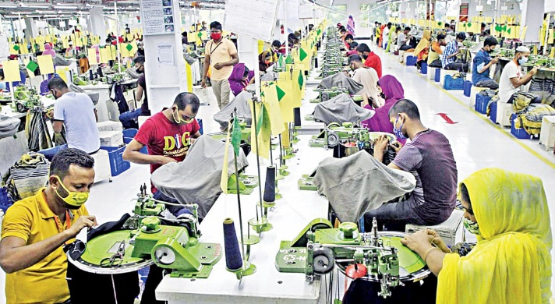
TOPIC: GARMENT INDUSTRY OF BANGLADESH

Slide 5
Contents to be covered
Introduction
Background
Objective
Raw Materials
Mission
Data Presentation
Market Potential
Capacity Utilization
Ideas behind Smart Factory
Advantages & Disadvantages
Conclusion

Slide 6

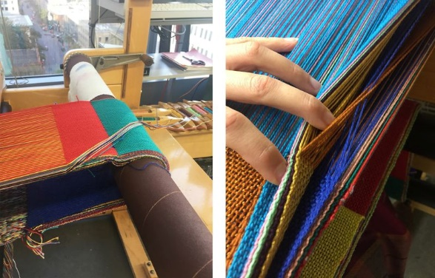
Introduction
Bangladesh is virtually located as a bridge between the emerging markets of South Asia and fastest growing markets of South East Asia and ASEAN countries. With the proposed concept of a "Bay of Bengal Growth Triangle" with its apex Chittagong port extending south-west to Calcutta, Madras and Colombo and the south-eastern arm extends through Yangon, this region should have growing attention of the investment world.

Slide 7
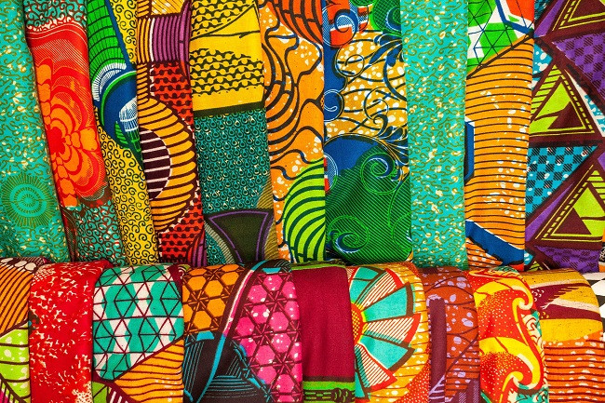
Background:
The Bangladesh economy is helped by its big readymade garment (RMG) industry sector, which contributes more than two-thirds of the country’s trade.
This reflects the continued high growth of exports, increased flows of remittances, moderate growth in money supply as well as that of imports.

Slide 8
Objective
Identifying barriers and challenges of this sector.
Analyze future prospects of Garment Industry.
Identify possible opportunities and threats
To gather insightful knowledge about the Garment sector of Bangladesh.

Slide 9
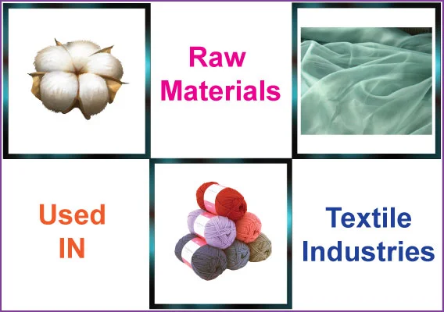
Raw Materials
Fibers
Dyes
Chemicals

Slide 10
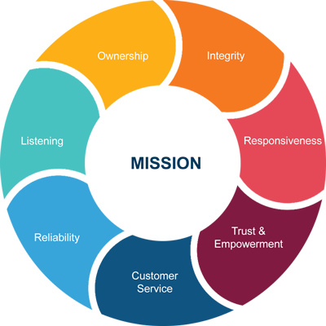
Mission
To advance knowledge and pushing the boundaries in fashion, textiles and design.
To support and collaborate with fashion, textiles and design industry to achieve a sustainable progress.
Be a market leader in the field of value retailing.
Provide fashionable products at affordable prices.

Slide 11
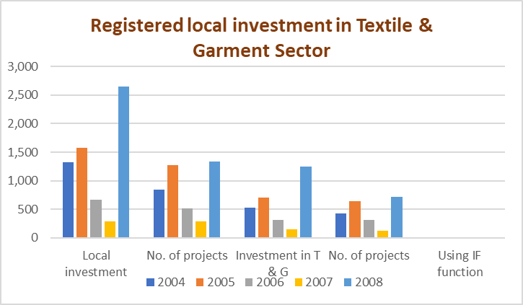
Data Representation
Year | Local investment | No. of projects | Investment in T & G | No. of projects | Using IF function
2004 | 1,328 | 840 | 525.25 | 427 | Good
2005 | 1,578 | 1277 | 703.19 | 647 | Best
2006 | 663 | 520 | 316.79 | 313 | Good
2007 | 283 | 286 | 147.93 | 117 | Good
2008 | 2,650 | 1334 | 1,244.89 | 713 | Best

Slide 12
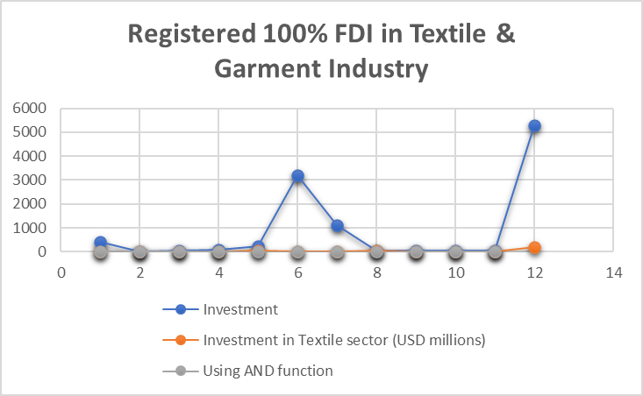
Observed Data
Year | Investment | Investment in Textile sector (USD millions) | Using AND function
2000 | 406.7 | 3.55 | TRUE
2001 | 11.26 | 10.17 | TRUE
2002 | 35.96 | 5.21 | TRUE
2003 | 83.52 | 10.94 | TRUE
2004 | 224.81 | 56.24 | FALSE
2005 | 3,197.62 | 16.14 | FALSE
2006 | 1,120.82 | 11.61 | FALSE
2007 | 55.16 | 33.66 | FALSE
2008 | 65.58 | 6.19 | TRUE
2009 | 44.69 | 20.49 | TRUE
2010 | 36.44 | 4.2 | TRUE

Slide 13
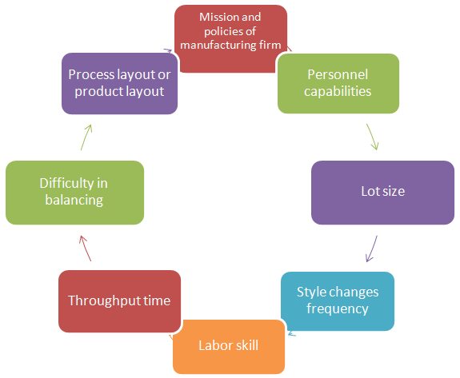
Process Flow:

Slide 14
Market Potential
Revenue
The apparel market in Bangladesh is expected to generate $10.52 billion in revenue in 2024.
Growth
The market is expected to grow at a rate of 3.52% annually from 2024 to 2028.
Export revenue
Bangladesh's garment industry contributes 85% of the country's export revenue.
Employment
The garment industry employs over 4 million people.

Slide 15
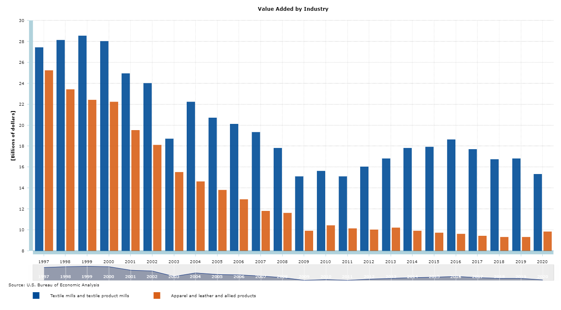
Capacity Utilization

Slide 16
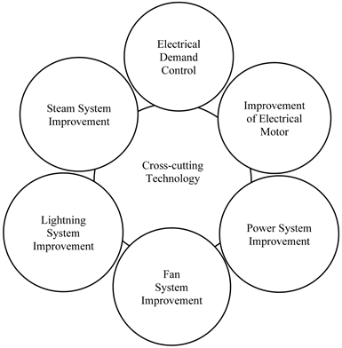
Motive Power Required
Electric industrial forklift trucks in distribution and manufacturing facilities.
Ground support equipment used in airports.
Mining equipment

Slide 17
Ideas behind Smart Factory
Robots are smart devices
Sensors
Factory layouts
IOS
Humans

Slide 18
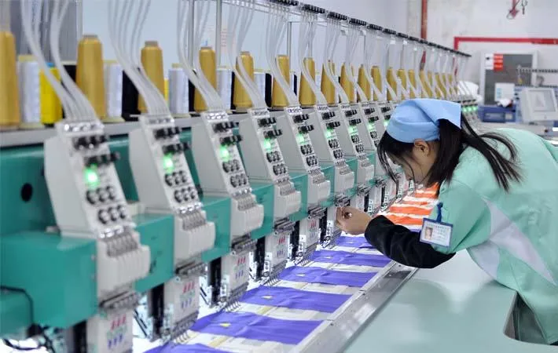
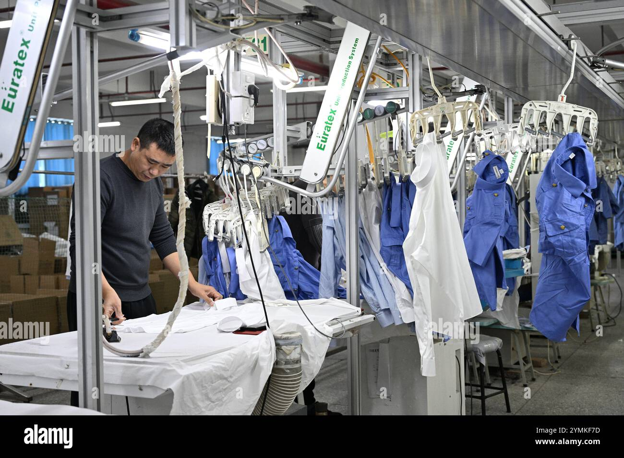
Advantages & Disadvantages
Advantages
Disadvantages
Job Creation;
Economic Growth;
Global Trade;
Technological Advancements.
Exploitation of Labor;
Environmental Impact;
Fast Fashion Culture;
Health & Safety Risks.

Slide 19
Conclusion
Bangladeshis are recognized all over the world for their fashion; the fashion statement is not only limited to celebrities but applies for the common masses as well. For the garment industry in Bangladesh, industrialization has proved to be a blessing. Complying with the changing tastes of people and evolving market trends, the garment manufactures in Bangladesh are continuously striving to be innovative. Bangladesh is engaged in heavy export of garments to the international markets.

Slide 20


